Slide 1
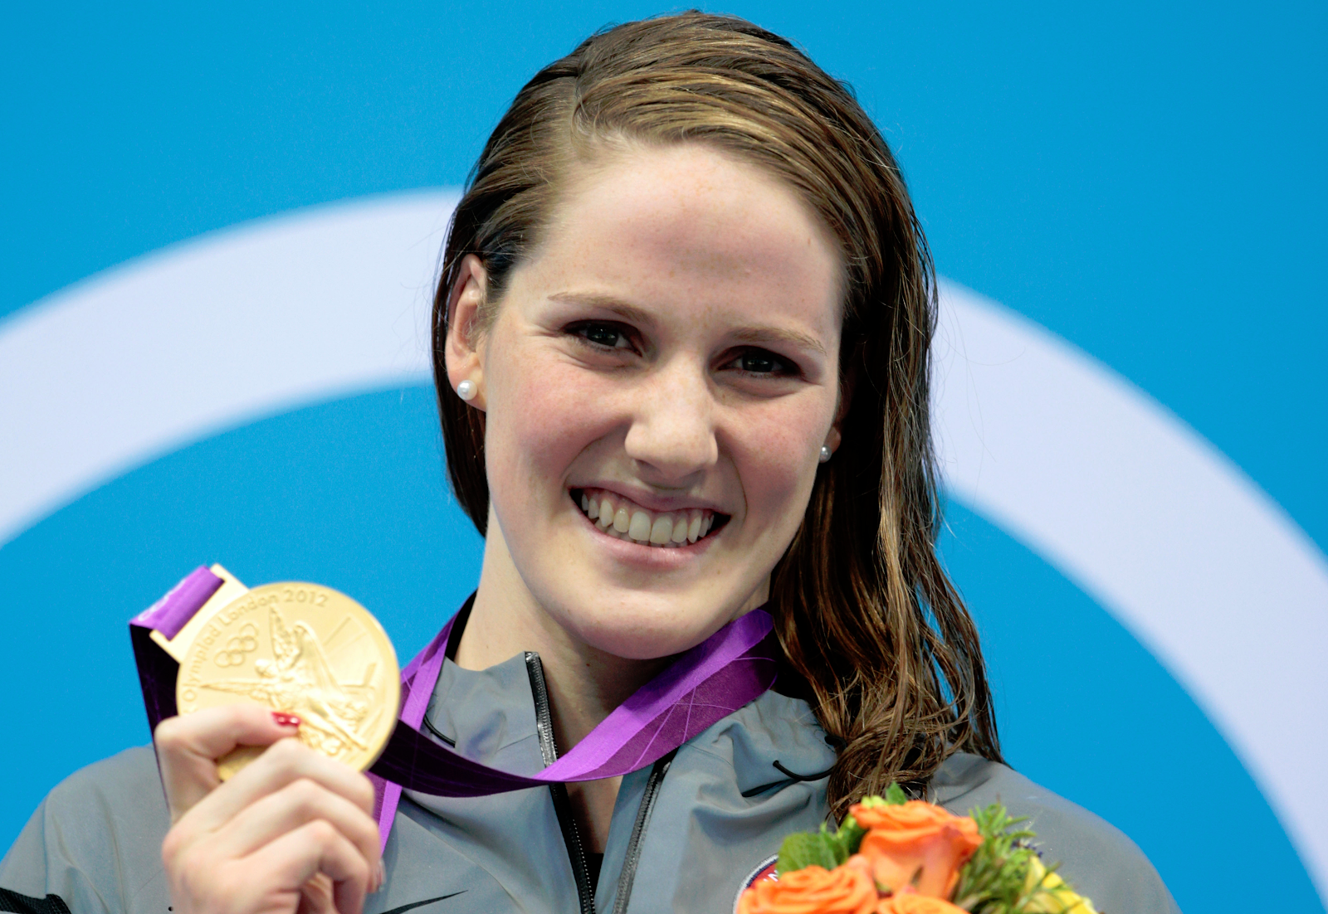
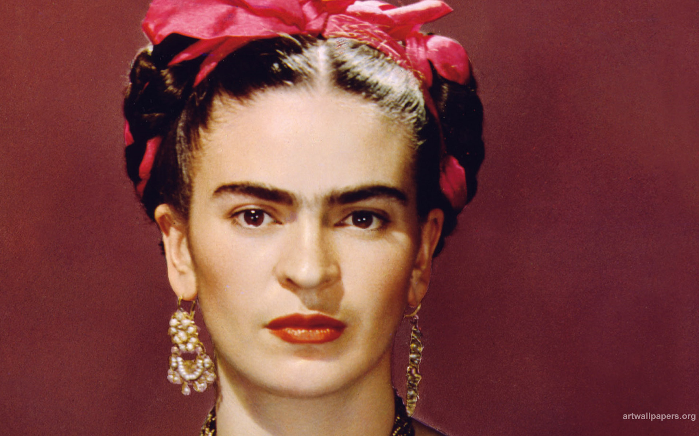
Frida Kahlo and Missy Franklin
By: Diana Reyes and Chantal Merino

Slide 2
Hello Frida,
I would love for you to make me a painting of me while I am swimming the 200 free at the 2016 Summer Olympics. It would be an honor for you to paint my picture. You are the only great artist that I know. I will be paying you $200.
Thank You
~Missy Franklin
Hi Missy,
This is Frida…… Of course I will make portrait of you. It will take me a while, but don’t worry it will be amazing
From your friend,
Frida Kahlo

Slide 3
Hello Frida,
Here is some information on me:
~ I was born on May 10th 1995 in Pasadena, California
~ When I was five (5) I started to swim
~ No, I am an only child
-Missy
Hi Missy,
This is Frida.
I wanted to know a little more about you, so I hope you can answer some of my questions.
Where were you born?
How old were when you started swimming?
Do you have any siblings?

Slide 4
Hi Missy,
I will gladly give you some information about me:
~ I was born July 6th 1907 in, Coyoacán, Southwest of Mexico City
~ Yes I do have a husband and his name is Diego Rivera
~ I started after several injuries because I wasn’t able to move around as much.
Hello Frida,
I was also wondering if you could answer some questions I have for you:
When were you born?
Did you have a husband, and if so, what was his name?
Why did you start to paint?

Slide 5
Hello Frida,
I was wondering if you would like to come up with 3 differences between us and I will come up with 3 similarities between us. Please let me know what you think of that.
~Missy Franklin
Hi Missy,
I would love to come up with 3 differences about us.
I will write you back when I have my differences.
-Frida Kahlo.

Slide 6
Hello,
Thank you so much for agreeing to take your time into finding the 3 differences. I really appreciate that. I found three similarities between us:
We both are very famous people
Both you and I have great hobbies that we are interested in
You and I are both very artistic in our own way
~ Missy Franklin
Hello Missy,
I have come up with 3 differences about us.
1) I am a painter and you are a swimmer.
2) I paint self-portraits and you win medals when swimming
3) You are in the water and I paint.
-Frida Kahlo

Slide 7
Hi Missy,
It was a pleasure talking to you!
Unfortunately, I am very sick and I will probably be gone very soon, but don’t worry I will live my life until the end!! :) I have already made your painting and I will send it you by mail…. Hope you love it!!!!
-Frida Kahlo
Hello,
Thank you so much for everything. It was a pleasure meeting and talking to you at the 2016 Olympics.
~ Missy Franklin

Slide 8
Thank You We Hope You Enjoyed!

